Slide 1
Node and MongoDB

Slide 2
Objectives
Understand the Node MongoDB Driver
Configure your Node application to communicate with a MongoDB server
Perform CRUD operations on the MongoDB server from Node application
Callback Hell and Promises

Slide 3
What Node MongoDB Driver?

Slide 4
What Node MongoDB Driver?
Provides a high-level API for a Node application to interact with the MongoDB Server
Installation: npm install mongodb
The Node MongoDB driver supports several operations that can be performed from a Node application:
Connecting to a MongoDB
Inserting, deleting, updating and querying documents
Supports both callback based and promise based interactions

Slide 5
Installing the Node MongoDB Driver Module

Slide 6
Install the Node MongoDB driver
Create a new folder named node_mongo and move into the folder.
At the prompt, type the following to initialize a package.json file in the node_mongo folder:
npm init

Slide 7
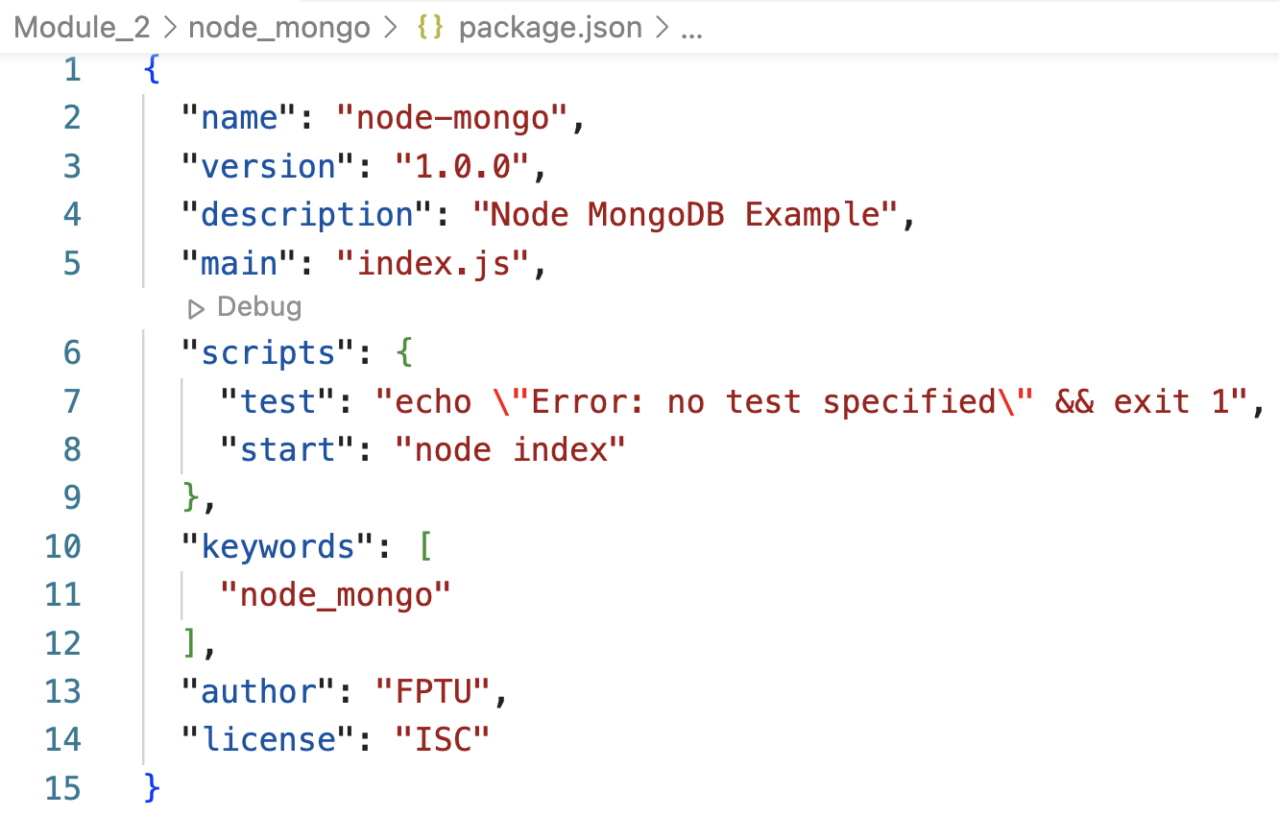
Install the Node MongoDB driver
Accept the standard defaults suggested until you end up with a package.json file containing the following:

Slide 8
Install the Node MongoDB driver
Install the Node MongoDB driver and the Assert module by typing the following at the prompt:
npm install mongodb
npm install assert

Slide 9
A Simple Node-MongoDB Application

Slide 10
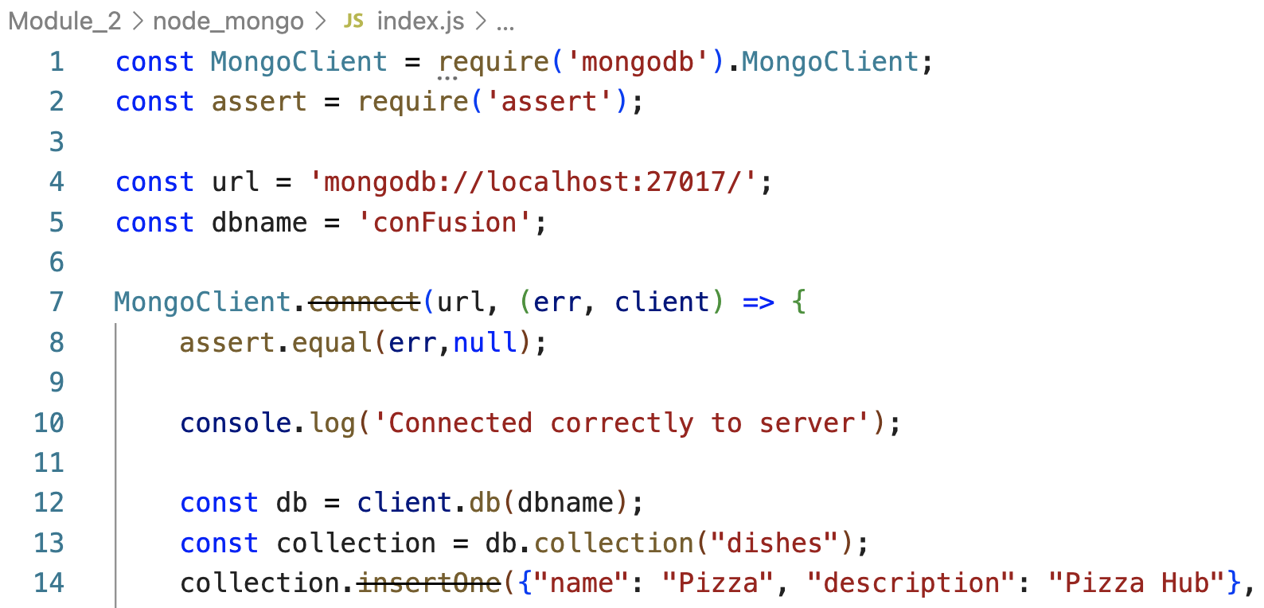
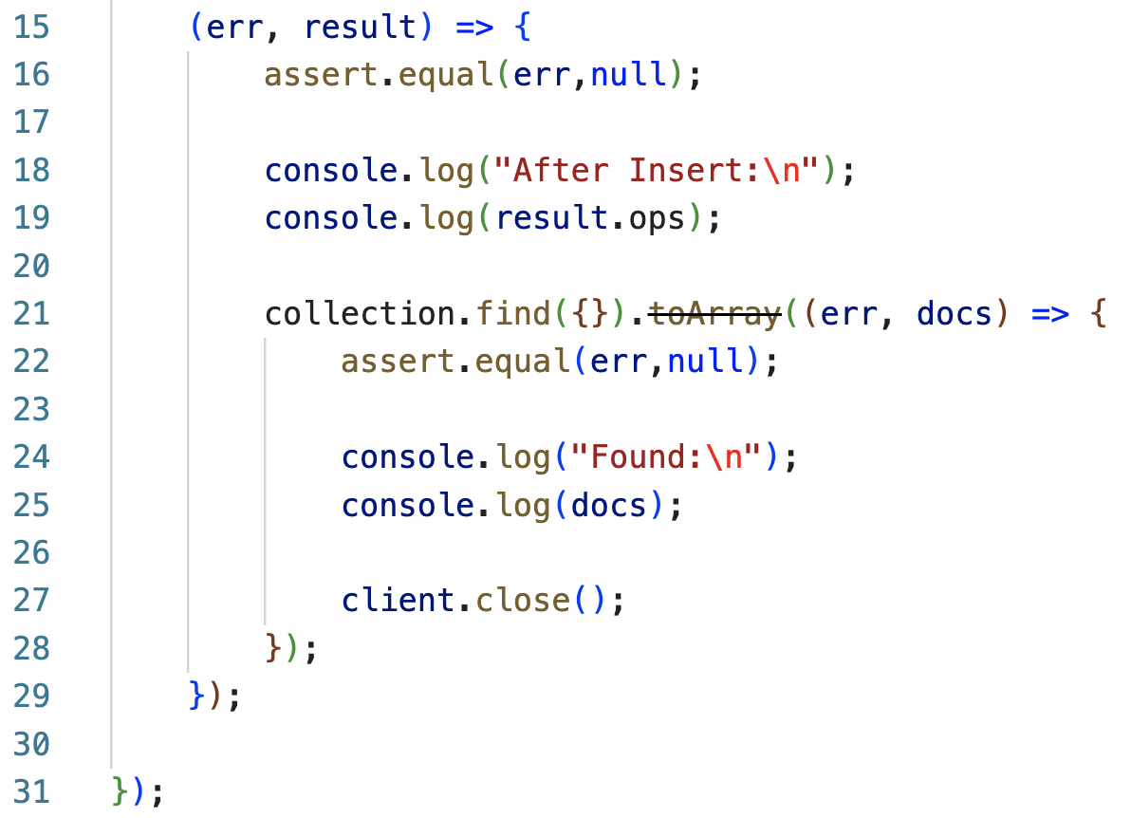
Create a simple Node - MongoDB application
Create a new file named index.js and add the following code to it:

Slide 11
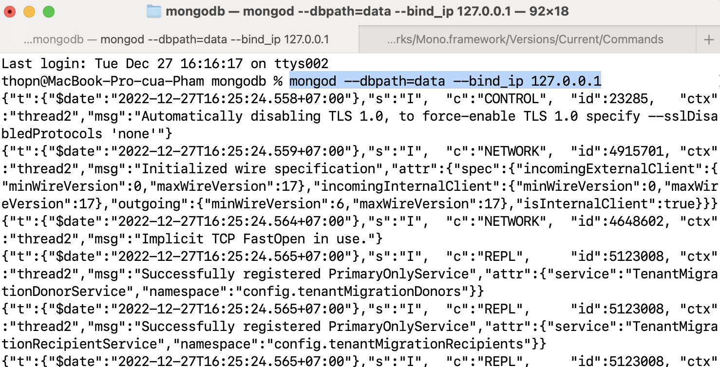
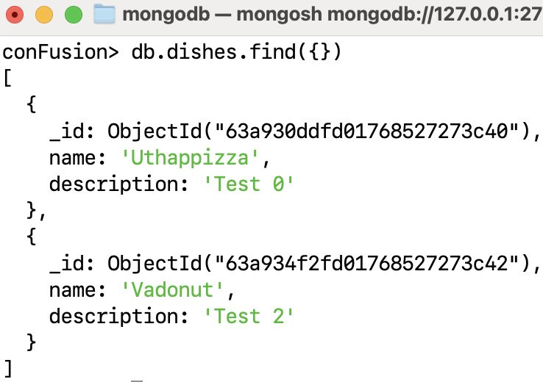
Run Node - MongoDB application
Make sure that your MongoDB server is up and running
Original data

Slide 12
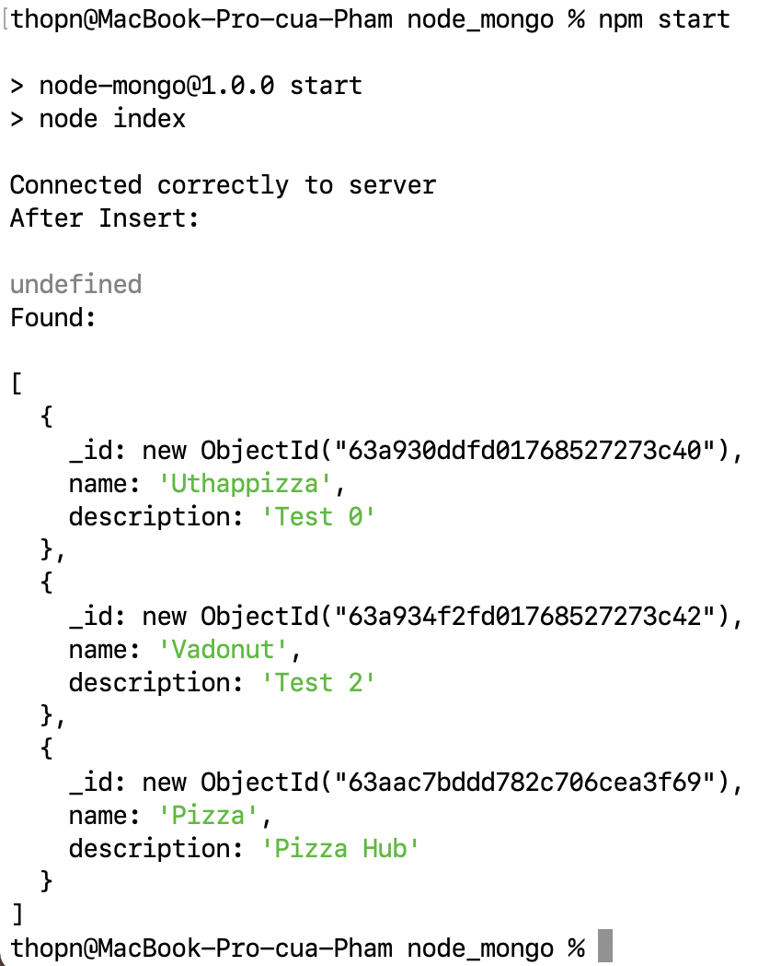
Run Node - MongoDB application
Type the following at the prompt to start the server and see the result.
npm start
A new document

Slide 13
CRUD operations on the MongoDB server from Node application

Slide 14
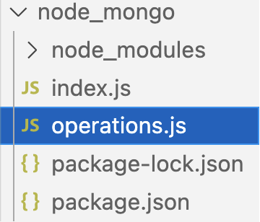
Implementing a Node Module of Database Operations
Create a new file named operations.js that contains a few MongoDB operations:
Create
Read
Update
Delete

Slide 15
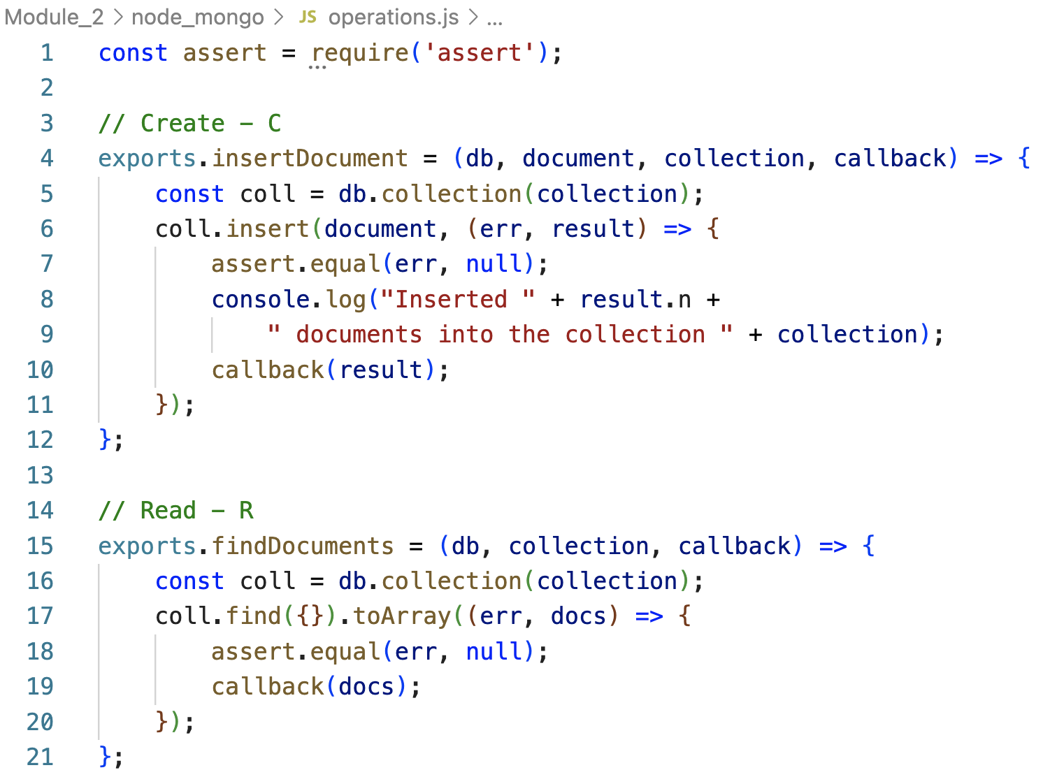
Implementing a Node Module of Database Operations
operation.js:

Slide 16
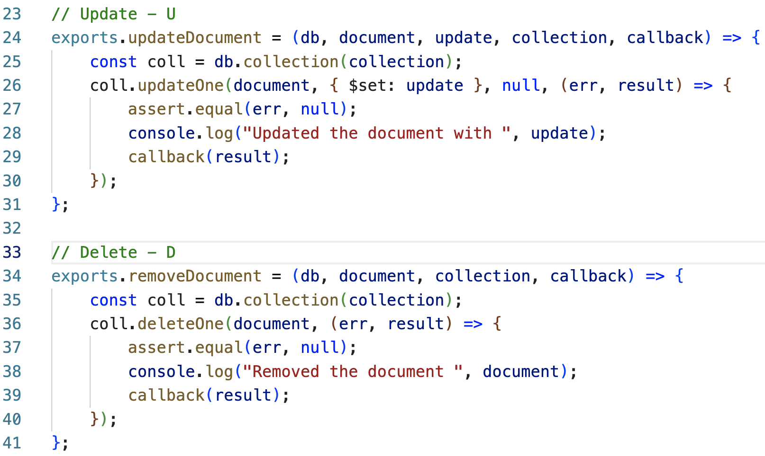
Implementing a Node Module of Database Operations
operation.js:

Slide 17
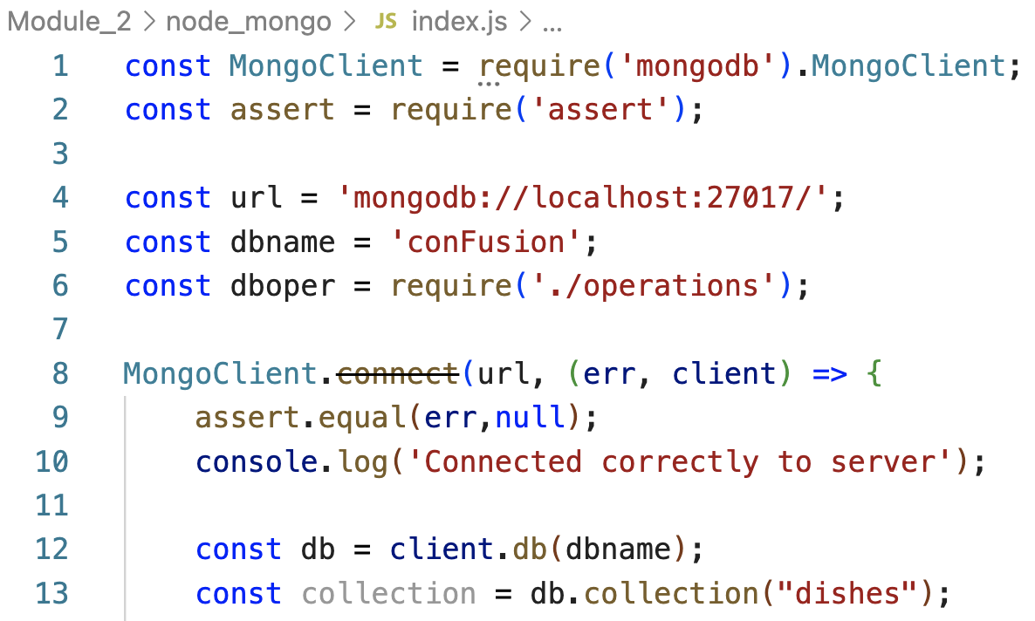
Using the Node Module for Database Operations
Update the file named index.js as follows:

Slide 18
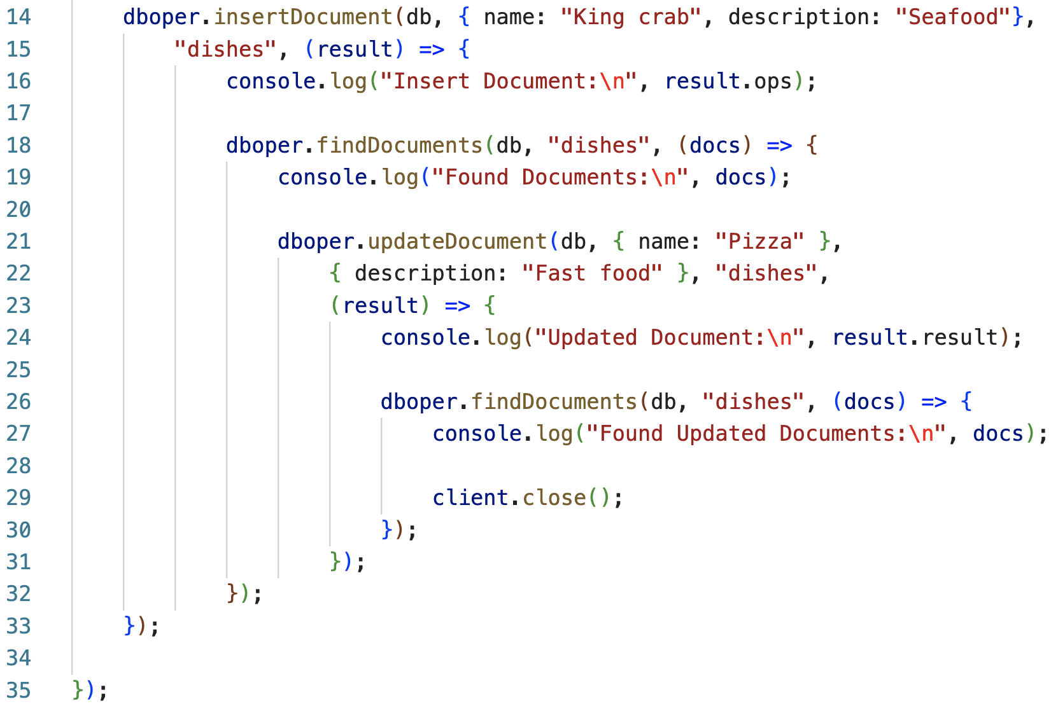
Using the Node Module for Database Operations
Update the file named index.js as follows:

Slide 19
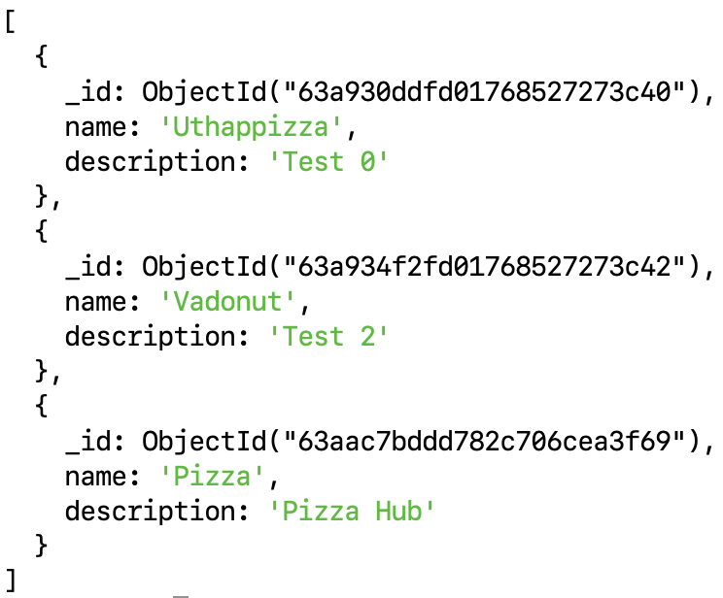
Run Node - MongoDB application
Run the server by typing the following at the prompt and observe the results:
npm start
Current data:

Slide 20
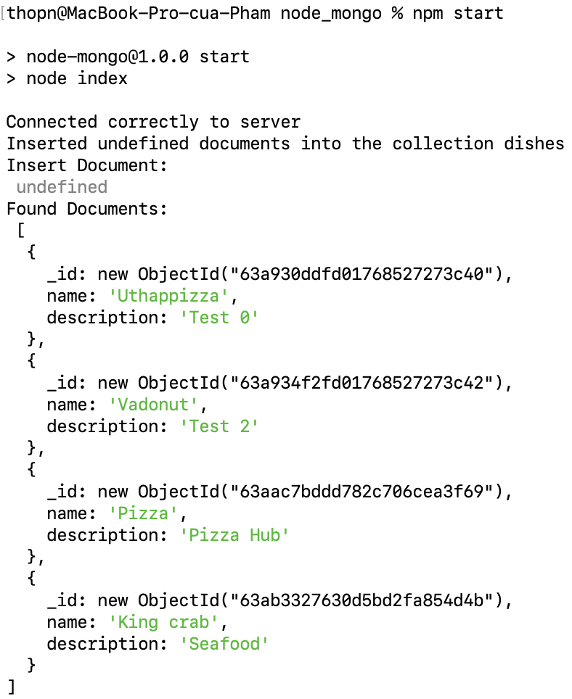
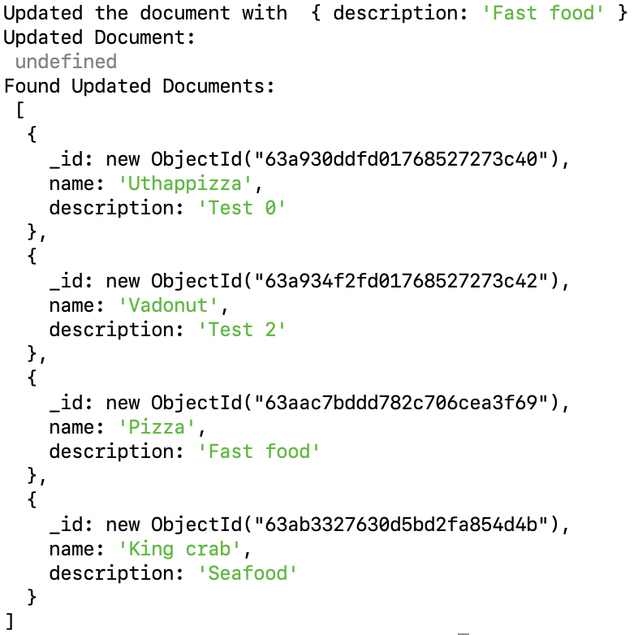
Run Node - MongoDB application
Updated:
Added:

Slide 21
Callback Hell and Promises

Slide 22
Callback Hell
Heavily nested callback code
Results from our tendency to write code top to bottom
Pyramid of doom
Can use promises to tame it
Tries to preserve the top-down appearance of the code

Slide 23
Promise
Promise is a mechanism that supports asynchronous computation
Proxy for a value not necessarily known when the promise is created:
It represents a value that may be available now, or in the future, or never
Promise
(pending)
resolve/fulfill
reject
Promise
(resolved/fulfilled)
Promise
(rejected)
new Promise(function (resolve, reject){…});

Slide 24
Why Promises?
Solves the callback hell problem
Promises can be chained
Can immediately return:
Promise.resolve(result)
Promise.reject(error)

Slide 25
Consuming Promises
Consumers of promise are notified of the fulfillment or rejection of the promise
Register the callbacks to handle fulfillment and rejection with the .then()
can be chained
Use .catch() for handling errors
Example
promise .then( () => { })
.catch( () => { });

Slide 26
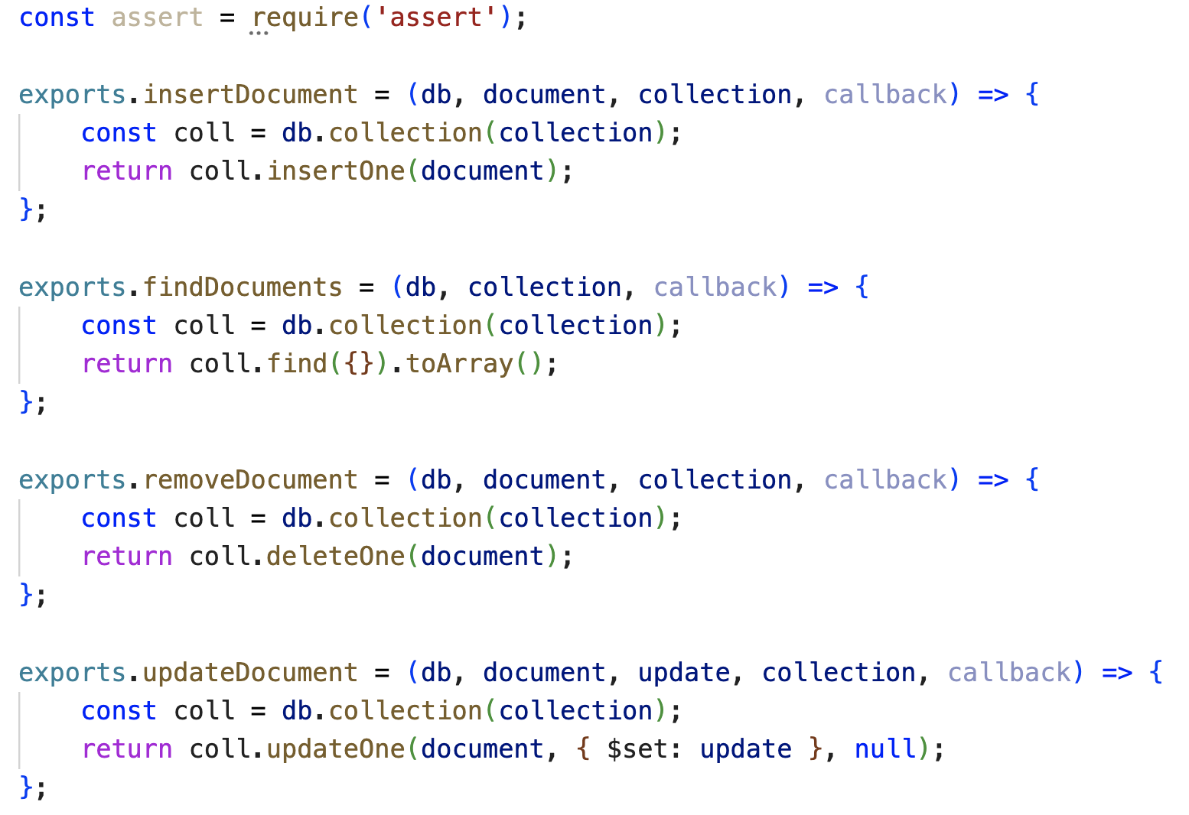
Update operations.js

Slide 27
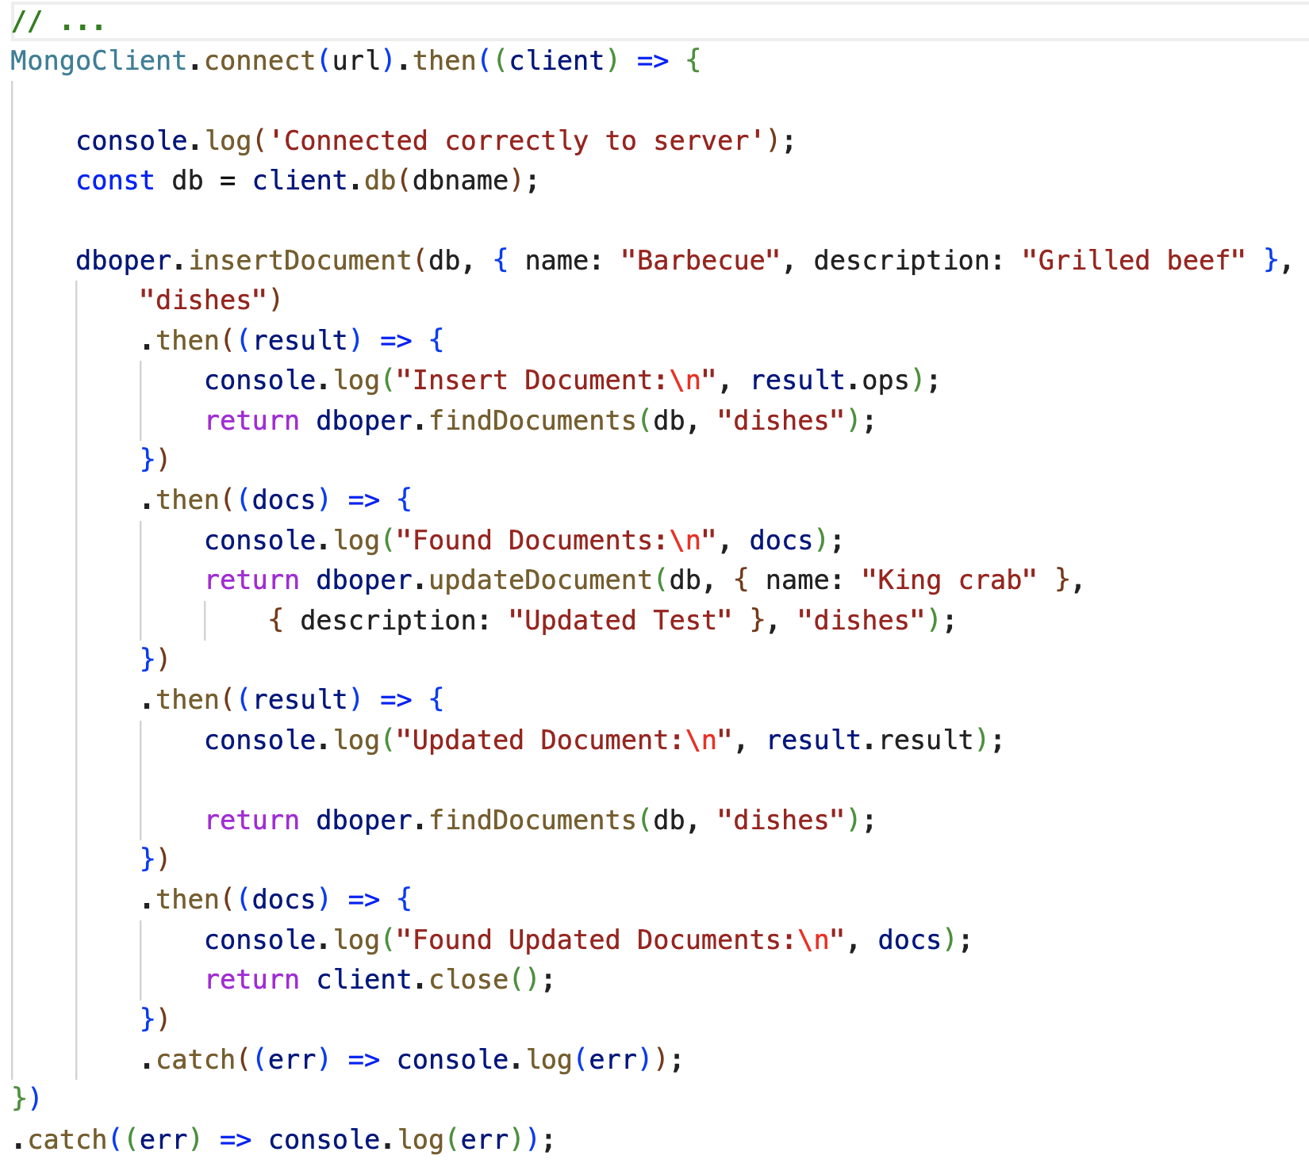
Update index.js

Slide 28
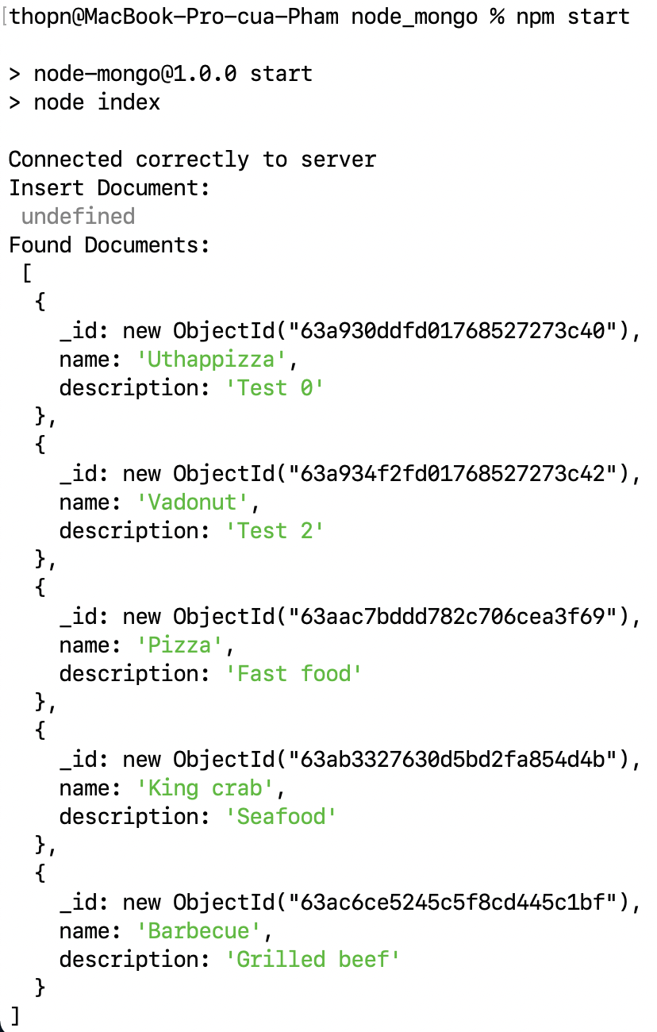
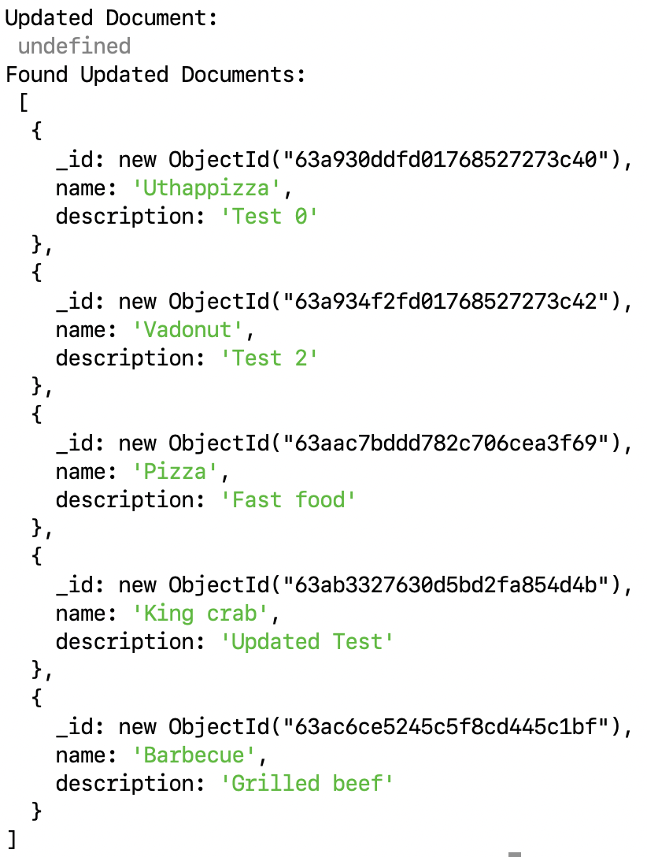
Run the node application and see the result
Updated:
Added:

Slide 29
Summary
Understand to configure Node application to communicate with a MongoDB server
Perform CRUD operations on the MongoDB server from Node application
Understand Callback hell
Using the Promise to solves the callback hell problem

